Slide 1
Docker, .NET Core, and Entity Framework
Nate McMaster
Software Engineer, ASP.NET
@natemcmaster

Slide 2
Talk source code
github.com/natemcmaster/docker-ef-talk

Slide 3
Agenda
The stack, from the bottom up
Docker
.NET Core
Entity Framework
Putting it all together
Q/A

Slide 4
https://www.docker.com/what-docker

Slide 5
What is Docker?
Docker containers wrap up a piece of software in a complete filesystem that contains everything it needs to run:
code,
runtime,
system tools,
system libraries
anything you can install on a server.
This guarantees that it will always run the same, regardless of the environment it is running in.
https://www.docker.com/what-docker

Slide 6
What is Docker?
It works on my box but not in production
I need to call my IT admin to install ___ on all servers
localEnvironment.Equals(productionEnvironment)

Slide 7
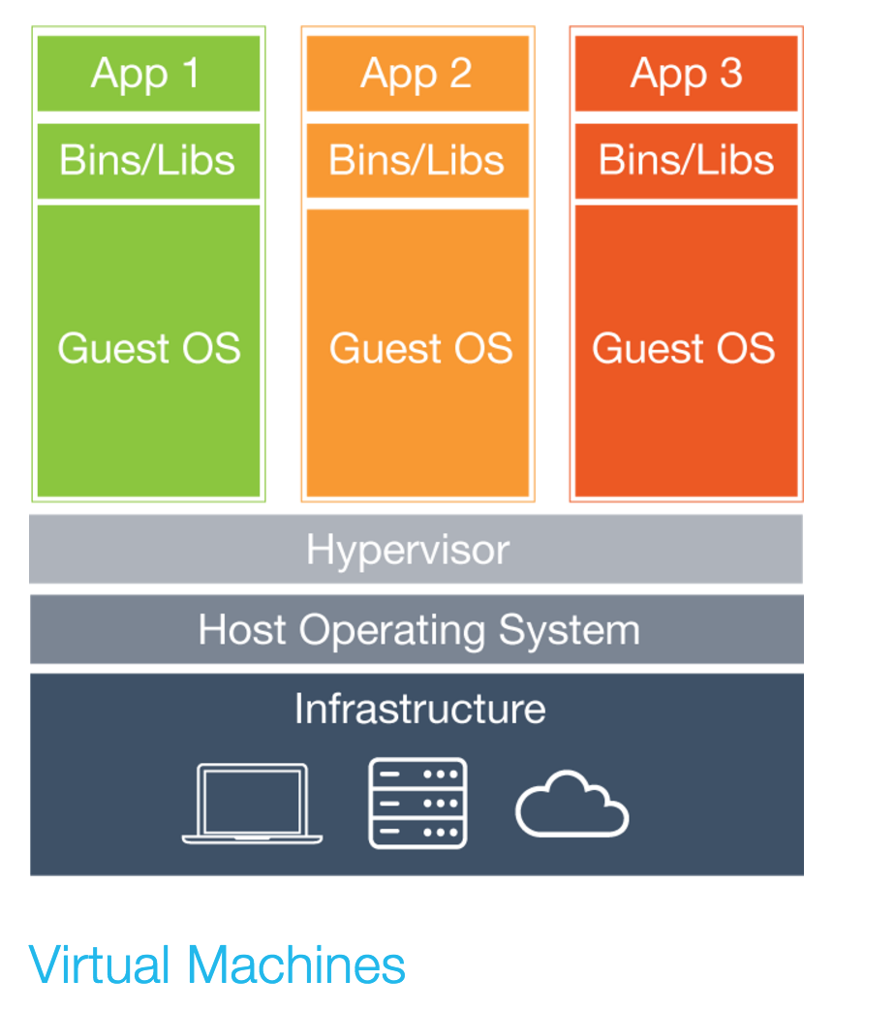
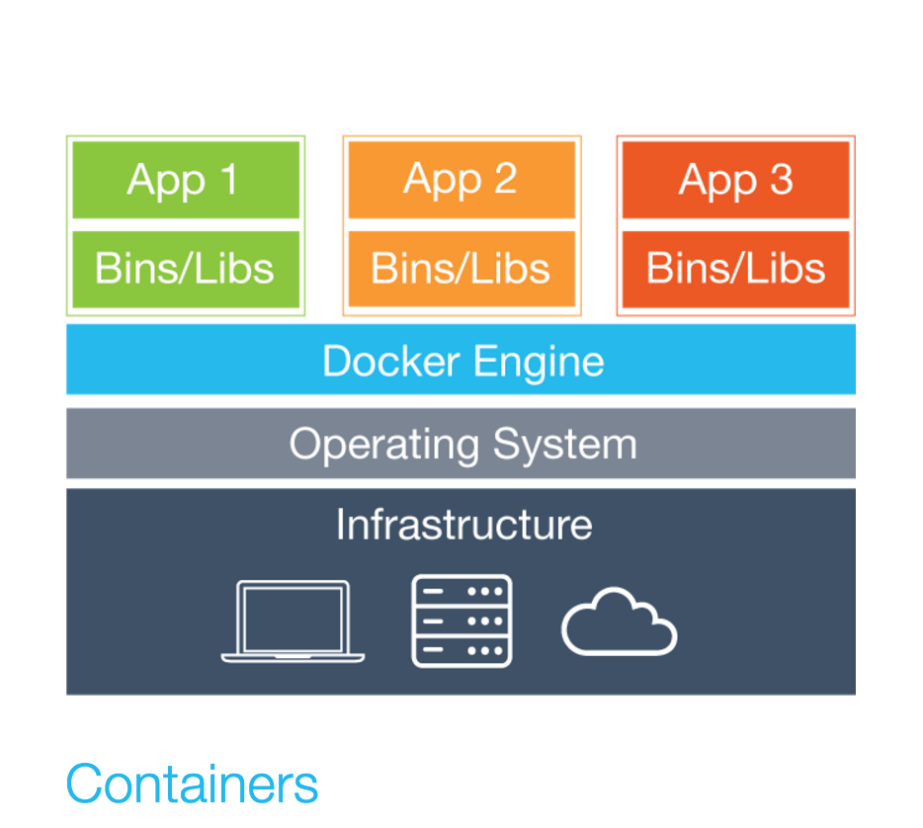
How is this different from a virtual machine?
https://www.docker.com/what-docker

Slide 8
What applications are available on Docker?
Dozens of popular, open-source database, web, and app servers
https://hub.docker.com/explore
https://www.microsoft.com/en-us/server-cloud/sql-server-on-linux.aspx

Slide 9
Docker demos
Notes:
- create and run Jenkins image
- show images vs containers
- what are volumes?
- networking

Slide 10
1 – Docker 101
Docker Toolbox
Docker machine
docker pull
docker run

Slide 11
2 – Docker demo
Volumes

Slide 12
2 – Docker demo
Creating a docker image
Other examples:
https://github.com/jenkinsci/docker/blob/5a51d0a519cb6605280adb8719f0e050ea69bac6/Dockerfile

Slide 13
.NET Core

Slide 14
.NET (Desktop)
Package management
NuGet
Build tooling
Debugging
IDE
Visual Studio
Compiler (C#)
Base class libraries
Execution engine (runtime)
global

Slide 15
.NET Core
DotNet CLI, VS Code, Visual Studio
Execution engine (runtime)
Base class libraries
Compiler
Build tools
Package mgmt
No longer global

Slide 16
.NET Core Glossary
Dotnet CLI | Command line tools for building and running .NET Core projects
Standalone app | A .NET Core application that does not rely on any shared installation of .NET
Portable app | A .NET Core application that relies on shared installation of .NET framework
Project.json | A json file that defines your project (replaces csproj)

Slide 17
Project.json glossary
Framework | Desktop .NET or .NET Core
Dependencies | NuGet packages that contain class libraries
Runtimes | Operating systems
Tools | Extensions of DotNet CLI, commands that execute on your project
http://dotnet.github.io/docs/project-model/

Slide 18
.NET Core Demos

Slide 19
.NET Core Demo
What’s in the “bin”?

Slide 20
Entity Framework Core

Slide 21



Entity Framework Core
EF 4-6 (System.Data.Entity)
Entity Framework Core (Microsoft.EntityFrameworkCore)
Core CLR
.Net Native
.NET Framework 4.6
.NET Core 1.0
Full .NET Framework for any scenario and
library support on Windows
Modular libraries & runtime optimized for server and cloud workloads

Slide 22
Entity Framework Core
Data access framework
Object-relational mapping
“Core” – a completely new version
For EF 6 users: think “port” not “upgrade”

Slide 23
EF Core Demos

Slide 24
All together

Slide 25
Docker Compose
Create multiple containers
Establish network links between containers
Central configuration for multi-container application

Slide 26
Docker compose demo

Slide 27
Feedback/questions?
nate.mcmaster@microsoft.com
github.com/natemcmaster/docker-ef-talk

